Slide 1




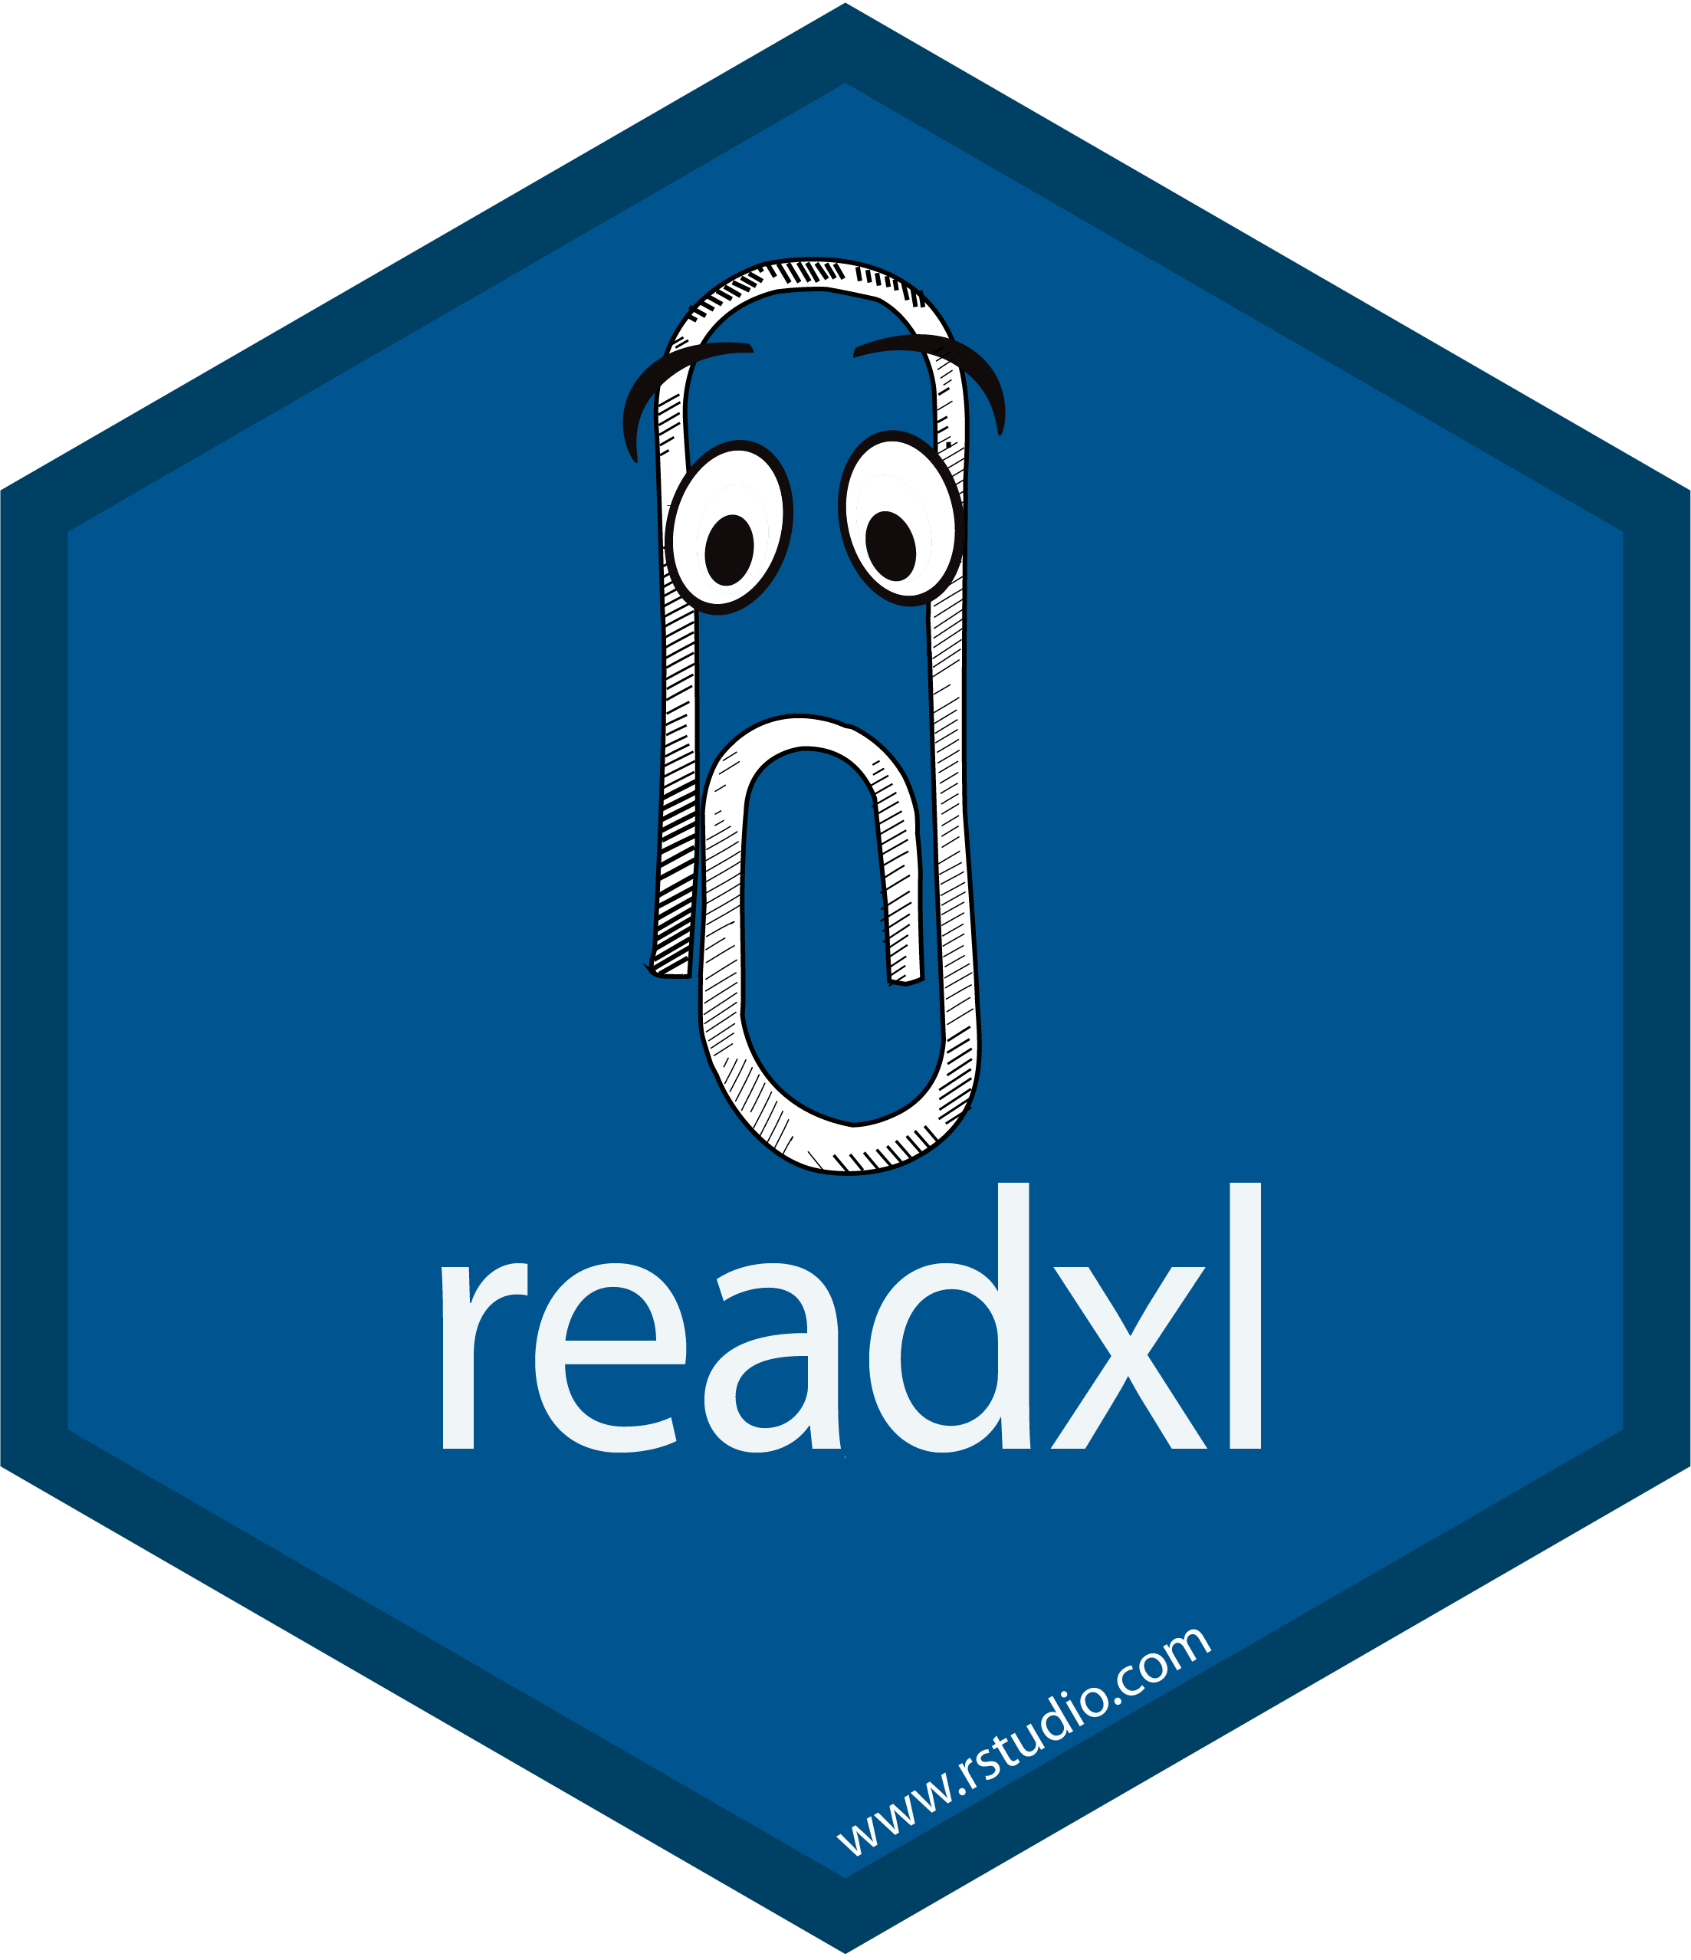
Import Data Into
Part 1 of Analytic with Tidyverse series

Slide 2



{Aep Hidayatuloh}
Nama Panggilan | : Aep
Daerah Asal | : Cikarang, Bekasi
Tempat Tinggal | : Cikarang, Bekasi
Pekerjaan | : - Senior Data Analyst at Starcore Analytics
 | - Customer Value Management at PT Asuransi Jiwa Sequislife
 | - Statistician & App Developer at PT Ganesha Cipta Informatika
Github | : https://github.com/aephidayatuloh
Email | : aephidayatuloh.mail@gmail.com
RPubs | : https://rpubs.com/aephidayatuloh
telegram community
R Indonesia
https://t.me/GNURIndonesia

Slide 3
{Prerequisite}
Internet Connection
Basic R Knowledge
Software Installed:
R program [https://cran.r-project.org/]
RStudio [https://www.rstudio.com/products/rstudio/download/]
Data & Scripts:
Download from https://github.com/aephidayatuloh/01-import
R Packages:
Use install.packages("tidyverse") to install tidyverse packages.
tidyverse | : | install.packages("tidyverse") | Collection of tidyverse package
readxl | : | install.packages("readxl") | For import from Excel file
writexl | : | install.packages("writexl") | For export to Excel file
dbplyr | : | install.packages("dbplyr") | The dplyr backend for database
RSQLite | : | install.packages("RSQLite") | SQLite interface for R
RMySQL | : | install.packages("RMySQL") | MySQL interface for R
jsonlite | : | install.packages("jsonlite") | JSON Parser and Generator for R

Slide 4
What Will Be Discussed?

Slide 5
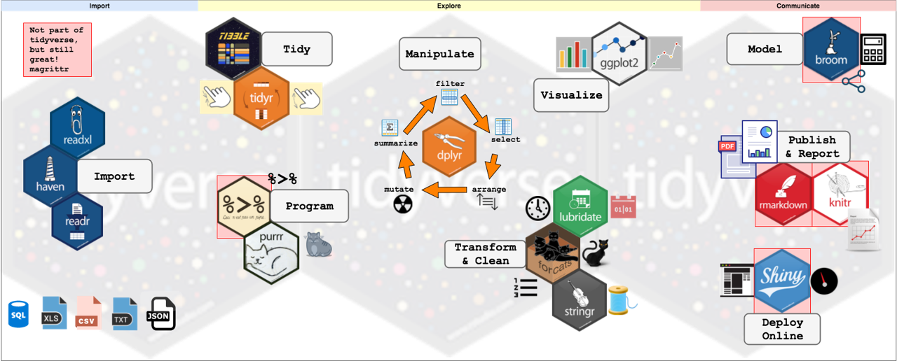
Tidyverse Series Flow

Slide 6

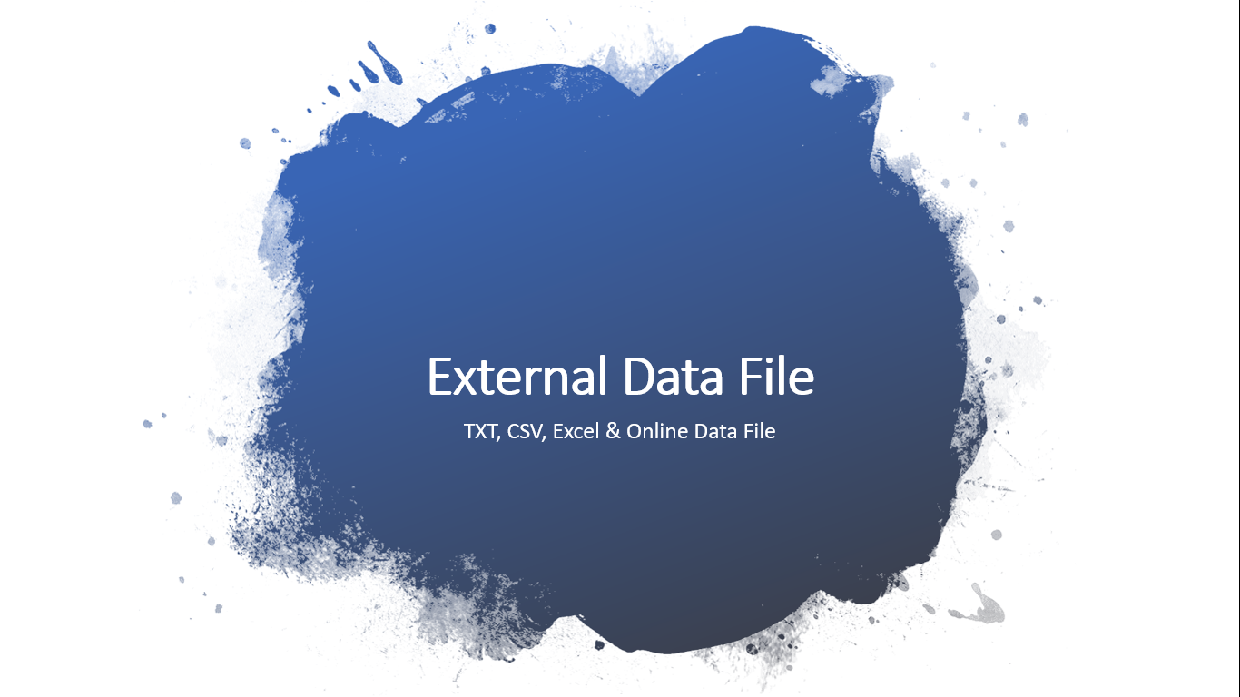
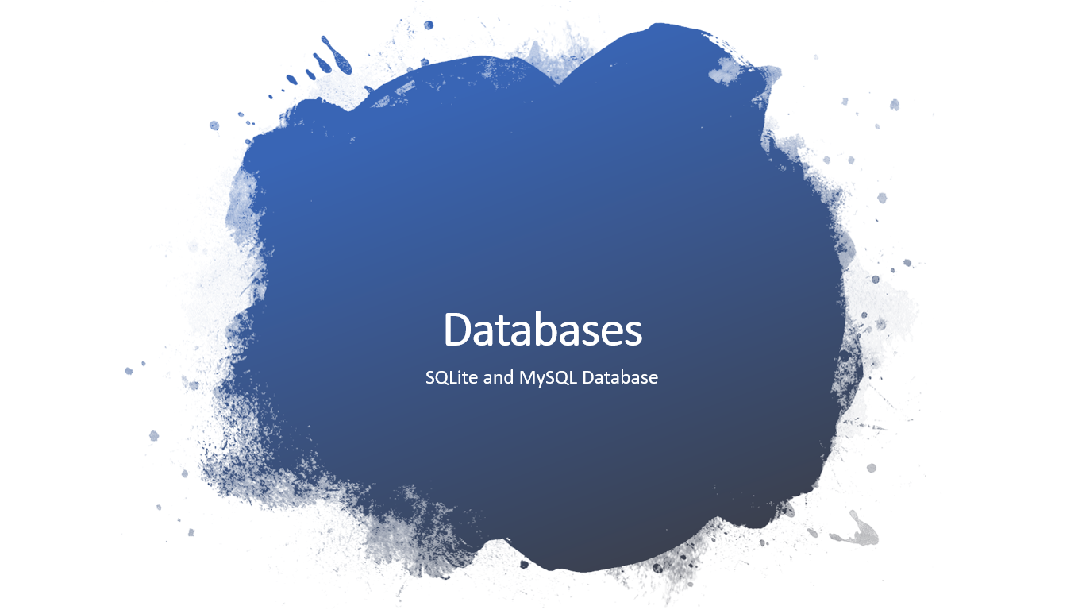
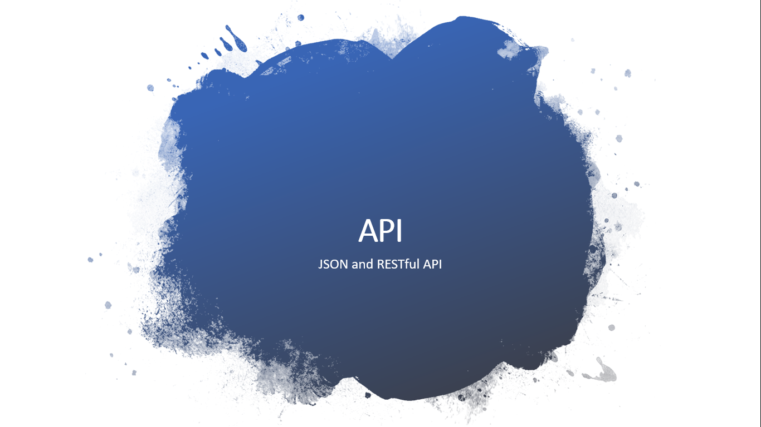
Outline

Slide 7
Introduction

Slide 8
Welcome to RStudio
RStudio is one of most used Integrated Development Environment (IDE) for R that makes it easy to build R script in more interactive mode.
i.e. auto-complete code, organized panel and many more useful functional.
RStudio is available in two formats:
RStudio Desktop -> program is run locally as a regular desktop application;
RStudio Server -> allows accessing RStudio using a web browser while it is running on a remote Linux server.
RStudio Desktop and RStudio Server are both available in free and fee-based (commercial) editions.
Download latest version of RStudio [https://www.rstudio.com/products/rstudio/download/]

Slide 9
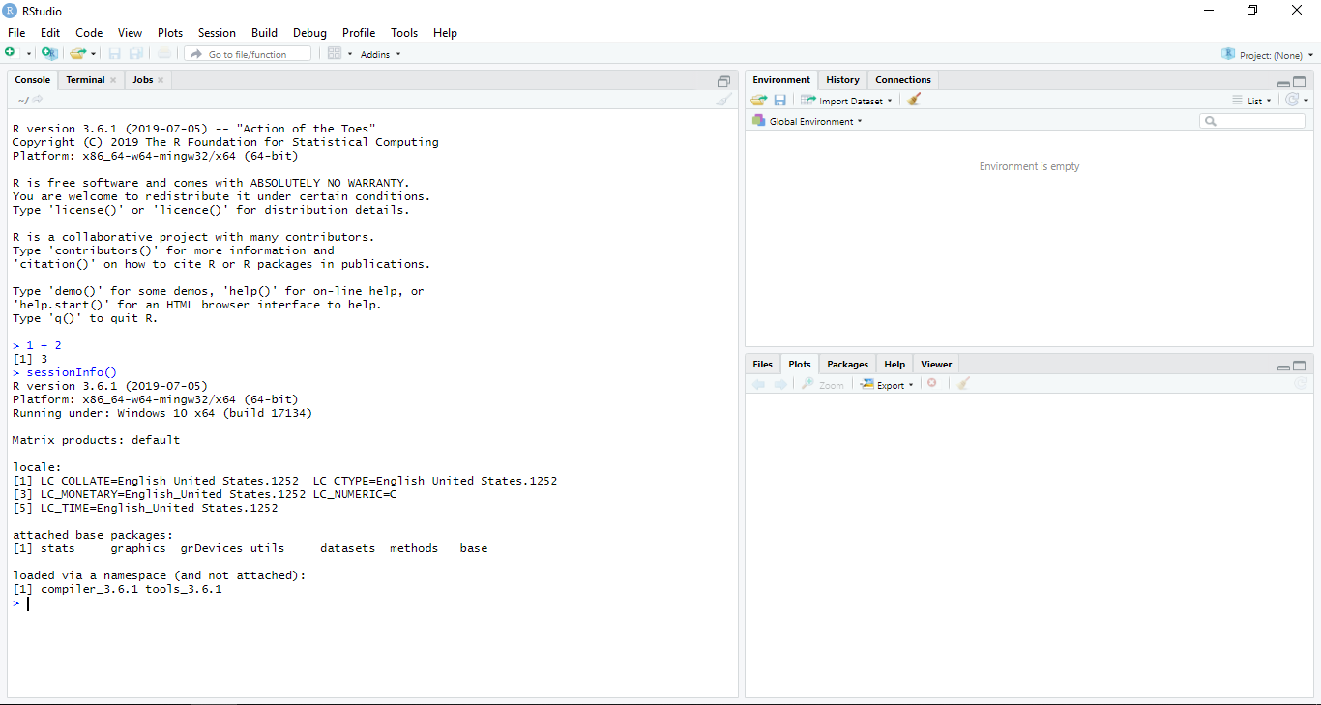
RStudio
Console/Terminal/Jobs
Environment/History/
Connections
Files/Plots/Packages/
Help/Viewer

Slide 10
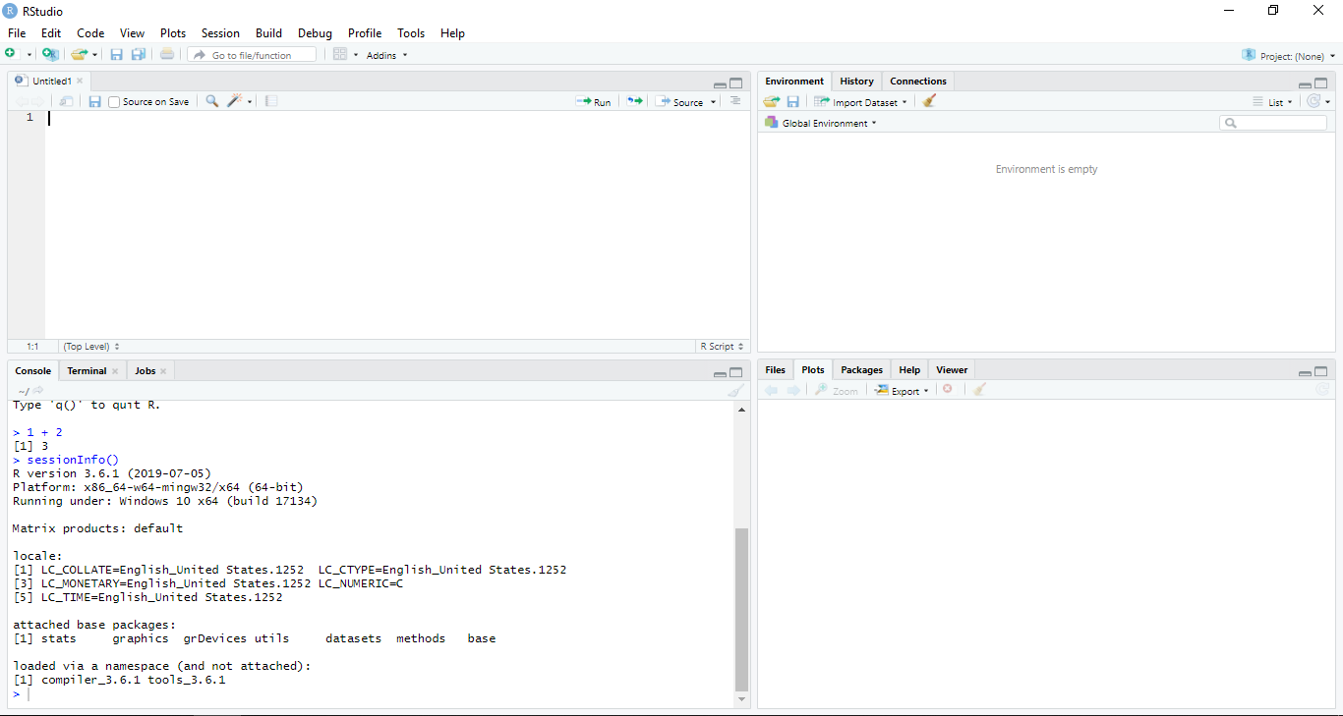
RStudio
Script Editor
File -> New File -> R Script
(Ctrl + Shift + N)
Environment/History/
Connections
Console/Terminal/Jobs
Files/Plots/Packages/
Help/Viewer

Slide 11
Outline

Slide 12
External Data File
TXT, CSV, Excel & Online Data File

Slide 13

Import TXT File
library(readr)
# or
library(tidyverse)
# Read File
iris_txt <- read_delim("../data/iris.txt", delim = " ") # space
str(iris_txt)
head(iris_txt)
# Write File
write_delim(iris, "../output/iris_out.txt", delim = "|")

Slide 14

Import CSV File
library(readr)
# or
library(tidyverse)
# Read File
iris_csv <- read_csv("../data/iris.csv")
str(iris_csv)
head(iris_csv)
# Write File
write_csv(iris, "../output/iris_out.csv")

Slide 15

Import Excel File
# Read File
library(readxl)
iris_xl <- read_excel("../data/iris.xlsx")
str(iris_xl)
head(iris_xl)
# Write File
library(writexl)
write_xlsx(iris, "../output/iris_out.xlsx")

Slide 16
Online Data File
Repository data : https://github.com/aephidayatuloh/datasets
Data location : https://raw.githubusercontent.com/aephidayatuloh/datasets/master/iris.csv
dt_url <- "https://raw.githubusercontent.com/aephidayatuloh/datasets/master/iris.csv"
gc <- read_csv(dt_url)
str(gc)
head(gc)

Slide 17
Challenge 1
Challenge: Read Online Data
Import a diamonds.csv online data file to RStudio from https://github.com/aephidayatuloh/01-import repository.

Slide 18
Outline

Slide 19
Databases
SQLite and MySQL Database

Slide 20


SQLite
SQLite is database with file-based → local or shared folder
Usually used as mobile/mini app database

Slide 21
SQLite
library(dplyr)
library(dbplyr)
file.exists("../data/rdb.sqlite") # check if SQLite DB file is exist
library(RSQLite)
dbcon <- dbConnect(SQLite(), "../data/rdb.sqlite") # connect to SQLite DB
dbcon
db_list_tables(dbcon) # list table name in database
dbtmp <- dbcon %>% tbl("iris") # not a dataframe yet, see ?tbl.src_dbi
dbtmp
dbtbl <- dbtmp %>% collect() # import query result as dataframe
dbDisconnect(dbcon) # disconnect from SQLite DB

Slide 22
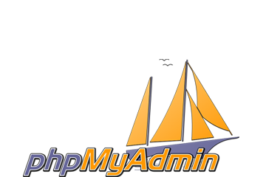


MySQL
MySQL is one of the world’s most popular database.
MySQL Workbench

Slide 23
MySQL
# library(dplyr)
# library(dbplyr)
library(RMySQL)
mycon <- dbConnect(MySQL(), username = "bdsvI1NRVz", dbname = "bdsvI1NRVz",
password = "ytbidFxi8X", host = "remotemysql.com",
port = 3306) # connect to MySQL DB
mycon
db_list_tables(mycon) # list table name in database
mytmp <- dbcon %>% tbl("iris") # not a dataframe yet, see ?tbl.src_dbi
mytmp
mytbl <- mytmp %>% collect() # import query result as dataframe
dbDisconnect(mycon) # disconnect from MySQL DB

Slide 24
Challenge 2
Challenge: Import Data From MySQL
Import table diamonds from database Database: bdsvI1NRVz Username: bdsvI1NRVz Password: ytbidFxi8X Server: remotemysql.com Port: 3306 Filter data with Premium cut, E color level, I1 clarity level, table and depth more than 60. Drop cut, color and clarity column. Then import the result as dataframe in R.

Slide 25
Outline

Slide 26
API
JSON and RESTful API

Slide 27
JSON File
JSON (JavaScript Object Notation)
Store & exchange data
library(jsonlite)
iris_json <- fromJSON("../data/iris.json") # import JSON file
str(iris_json)
head(iris_json)
write_json(iris, "../output/iris_out.json")

Slide 28
RESTful API
an Application Program Interface (API) that uses HTTP requests to GET, PUT, POST and DELETE data.
Web services based on REST (REpresentational State Transfer) architecture came to be known as RESTful web services.
library(jsonlite)
employee <- fromJSON("http://dummy.restapiexample.com/api/v1/employees")
str(employee)
head(employee)
write_json(employee, "../output/employee.json")

Slide 29
Challenge 3
Challenge: Import Data From API
Import data from https://infopemilu.kpu.go.id into a dataframe https://infopemilu.kpu.go.id/pilkada2018/pemilih/dpt/1/listNasional.json

Slide 30
Summary

Slide 31
??? {Q & A}

Slide 32
ThankQ

